Slide 1
Telecom Division TOA Development & Rollout Program

Slide 2
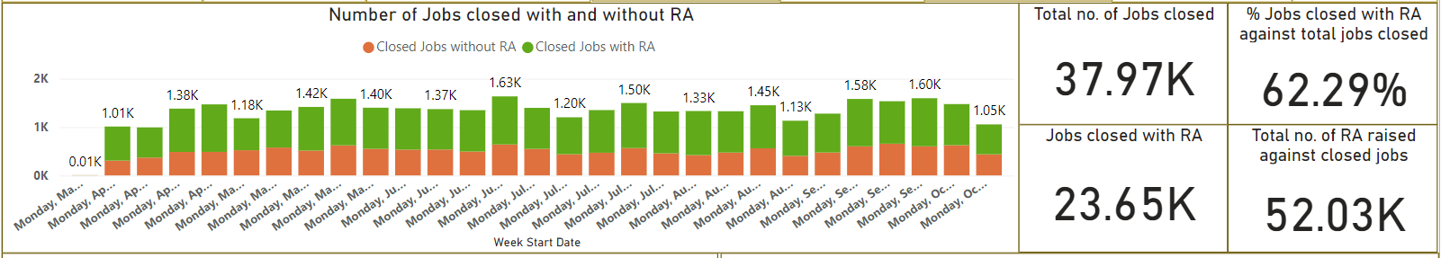
TDRA – 2.5 Active Users 1580 / 3501
Top 3 Subbies - Jobs closed with RA
I & A Communication Ltd – 67% compliance (2169)
Magdalene – 76% compliance (1865)
LJM Communication Ltd – 87% compliance (1507)
Bottom 3 Subbies - Jobs closed without RA
Centercomms Ltd – 1.1% compliance (1125)
I &A Communication – 67% compliance (1071)
Morrison Telecom Services – 25% compliance (998)
*Inc. eng comp failures and £1 pound closure.
TLF Utilities – 55% compliance (697)
Top 3 Regions - Jobs closed with RA
North West – 71% compliance (7407)
South East North – 68% compliance (7035)
South East South – 44% compliance (4007)
Bottom 3 Regions - Jobs closed without RA
South East South – 44% compliance (5040)
South East North – 68% compliance (3314)
North West – 71% compliance (3009)
Users Increased
48% current version
Action by SHEQ
Investigate the Job for further details, engage with suppliers to Identify best practice from top Suppliers/Regions and apply the same across board.

Slide 3
TDLW – 1.62 Active Users 166 / 875
Lone Working App Improvements
Update React Native Platform to .72
Introduce Number pad instead of OTP bring it in line with all apps
Flick Button Update
Improve reporting capabilities
Raised an R&D SR for No Signal Coverage/Offline
Recommended Solution
New Object in OptiMUS for Secondary System timer.
Ability to start and stop system timer with text message.
Ability to disable system timer on the App with new App and Text message notifications
Working on solution
How we can link apps from TDRA / TOA / TDLW vice versa
This is to force lone working engineers/operatives to use LW
Their whereabouts is very crucial and tracked
Help reduce using of multiple apps
Follow Up Action
Arun/Vad to follow up with Magdalene on the approach
Once approved we will submit the SR for Mobile & System
Users Decreased and Stagnant
31% current version

Slide 4
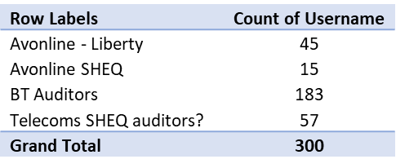
TOA – 1.5 Active Users 1087 / 2077
Last 45 operative users to be migrated after TOA 1.6
Pending Users (Avonline) To Be Migrated
Last batch of 45 (£371) operatives to be migrated after TOA 1.6
Saving of 1087 licence (£8968 / month)
Proposed Migration Approached
Looking at below two approaches and work with SHEQ and they taking ownership.
Remaining user re Supervisor/Auditors who uses Audit forms
1. WorkMobile AS-IS to TOA
Below SR’s to be reopened and reviewed before submitting for RA
Suspect the development efforts can be brought down to 30 ~ 40 days after RA confirmed.
WM Audits migration approx. efforts is 74 days
Telecom Operational Assurance – 12.25 days
On-Site Inspection – 25 days
CDM Audit – 10.25 days
Depot & Office – 15 days
API Integration – 12 days
2. Migrating from WM to TOA with new features and functionality
Phase 1
On-Site Inspection – approx. 18 days
API Integration - 12
Phase 2
Operational Assurance – *approx. 8.5
Phase 3
CDM Audit – *approx. 7
Depot / Office – *approx. 10
Increase in user
77% current version

Slide 5
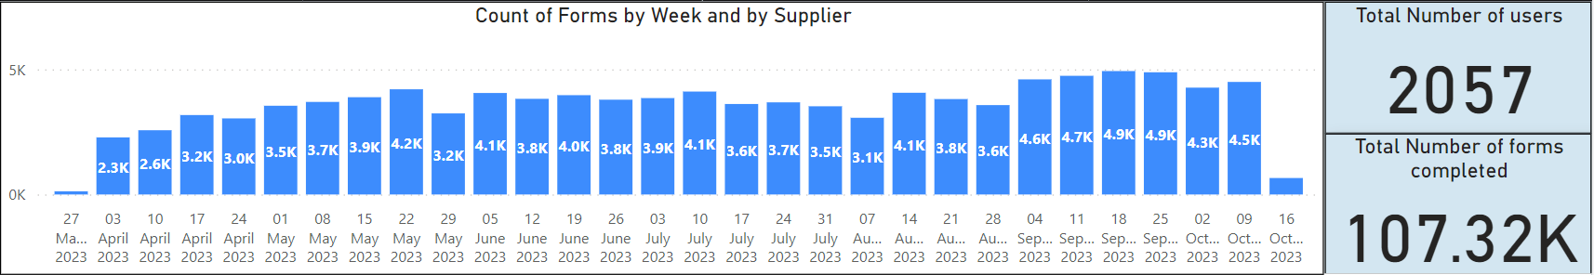
TOA Form Usage
Overall forms submitted 107K till date, below is the breakdown by quarter
Q1 – 45 K
Q2 – 53 K
Q3 – 9 K
We were started with submitting forms 2k / wk and now we are 4.25k / wk
We are looking to hit 6k per week by end of Q3
Below are the Top 10 forms used
Form Names | Count
Avonline Quick Photos | 31667
Civils Job Suite | 17467
Additional Photos | 14298
BT-10 | 14092
Flex Progress Photos | 5914
Box to Box Progress Report | 3476
Vehicle Audit | 3338
Poling Survey | 2968
Site Clear | 2512
Reinstatement Job Suite | 2152
Grand Total | 97884
Form Names | Count
QF015 - Site and Build Quality Audit | 22
Endorsement Form | 8
Damage Form | 6
Plant and Equipment Audit | 4
Supervisor Pre-Site Survey | 4
Avonline Pre Site | 3
SD Tools & Equipment Checklist | 0
Plant and Equipment Exchange | 0
Waldon Climbers Logbook | 0
Grand Total | 47
Top 10 Forms
Bottom 10 Forms

Slide 6
TOA Form Not being Used
ACTION NEEDED
iAuditor forms migrated to TOA
Allen – Escalate to SHEQ head as lack of engagement despite of meeting scheduled. We have the below 2 forms to be ready to be used.
Climbers Logbook
QF015 - Site and Build Quality Audit
Service Delivery
Allen – Can you please liaise as the (SD Tools & Equipment Checklist) form was requested by John but this was never used.
Avonline
Avonline Pre Site
MTS
Allen – Speak with Abby how to increase the usage of the forms
Endorsement Form
Damage
Allen – Speak with Darren/Richard Plant and Equipment Exchange
SHEQ
Allen – Need to engage with SHEQ to find out why the numbers of TOA users are low and it should be more than TDRA users.

Slide 7
FastField Migration 85 Users
Gigaclear Civils Forms – Migration of 85 users £1045
Completed
NOTICE - ACTUAL START REQUEST FORM
NOTICE - SITE CLEAR REQUEST
NOTICE/ PERMIT CANCELLATION REQUEST
NOTICE/ PERMIT EARLY START REQUEST
NOTICE/ PERMIT EXTENSION REQUEST FORM
NOTICE/ PERMIT REQUEST APPLICATION FORM
PERMIT MODIFICATION REQUEST FORM
Registration of Reinstatement
Waiting for Sign-Off
Gigaclear Install Pre-Check - PIA UG
Gigaclear Install Pre-Check - Traditional
Gigaclear Install Pre-Check - PIA OH
Standby Log Form
Shallow Utility Report form
GC Blockage Report
Tentatively to complete by end of Nov’23
Work with Stakeholder on Migration of Users
Training Sessions
Dec’23 ~ Jan’24

Slide 8
FastField Migration 15 Users
Ogi Forms – Migration of 15 users £180
Waiting for Sign-Off
A1024 Best Practice
AVL Site Safety Audit
Ogi - ANSL Supervisor PRE DIG CHECK (10 Pasi de urmat inainte de sapatura)
Ogi - NEC4 - EW/CE NOTIFICATION
Tentatively to complete by end of Dec’23
Working with Stakeholder on Migration of Users
Training Sessions
Dec’23 ~ Jan’24

Slide 9
FastField Migration 10 Users
IRS Forms – Migration of 10 users £123
List Forms sent to Nick Evans
Intro Meeting completed with follow up meetings lined
Tentatively to complete by end of Dec’23
Work with Stakeholder on Migration of Users
Training Sessions
Dec’23 ~ Jan’24

Slide 10
Mobile Platform Upgrade
We must ensure across all our Mobile apps the platform version has to be in sync to avoid any technical/compatibility issues
Action Needed:
Allen need your approval for TOA to be approved as can look at releasing TOA 1.7 in Dec’23/Jan’24
Mobile App Name | Current React Native Version | Dev Days | Approval Status
CPE | 0.63.3 | 6 (£2940) | Approved
TDRA | 0.63.3 | 6 (£2940)
TOA | 0.63.3 | 6 (£2940)
TDLW | 0.62.2 | 8 (£3920)
TAS | 0.61.5 | 8 (£3920)
CORE | 0.62.2 | 11 (5390)
Benefits
Security Vulnerabilities
Performance Issues
Compatibility Problems
Seamless User experience

Slide 11
TAS – 2.02 695 / 2604
Update React Native Platform to .72
Introduce Number pad instead of OTP bring it in line with all apps
Increase in user
26% current version

